Slide 1

Species ranges II – applied issues, dynamics (+ intro to metapopulations)
Petr Keil
Notes:
Hi, my name is Petr Keil and this is my project Biodiversity dynamics across a continuum of space, time, and their scales.

Slide 2
Geographic range vs extinction risk and conservation status
How small ranges make species vulnerable
Notes:
I am qualified to deliver all this

Slide 3
What increases extinction risk of a species?
Species biology:
Dispersal ability (Lees & Perez 2009): poorer dispersers are more at risk
Ecological specialization (Sekercioglu 2011): specialists are more at risk than generalists
Body size (Gaston & Blackburn 1995, Wang 2018): larger-bodied species are more at risk
Slow life history (Purvis et al. 2000): e.g. lower-fecundity species are more at risk
Biogeography:
Population size (O’Grady et al. 2004): smaller and declining populations are more at risk
Range size (Purvis et al. 2000, White & Bennett 2015)
Notes:
And this is what I will address
The grand objective is to figure out…
Specifically, BEAST will ………………………
I will do this in 5 work packages.

Slide 4
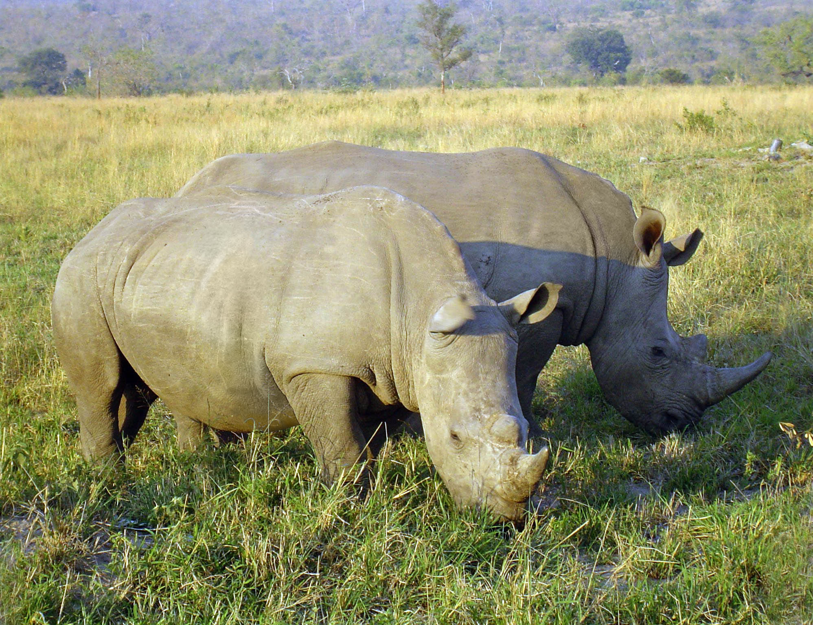
Why are species with small ranges more at risk of extinction?
No populations that can rescue the species if it goes locally extinct (e.g. due to human pressure)
More sensitive to demographic stochasticity
The rarer the more expensive, which further drives demand, which makes species evern rarer (example: rhino horns)
Local populations in species with small ranges decline faster due to habitat loss (Staude et al. 2019)
Photo: Wikipedia
Notes:
And this is what I will address
The grand objective is to figure out…
Specifically, BEAST will ………………………
I will do this in 5 work packages.

Slide 5

Red lists – IUCN
International Union for Conservation of Nature
1,400 member organizations, 16,000 scientists, budget of 95 m EUR in 2012, UN observer
World Conservation Congress, World Parks Congress
Members from CZ: AOPK, ČSOP, MŽP, KRNAP, UCSZOO
Main products:
- IUCN red list of ecosystems
- IUCN red list of species – based on population size (number of individuals), trends of population size, fragmentation, habitat quality, actual or potential exploitation, extent of occurrence (EEO), area of occurrence (AOO)
iucnredlist.org
Notes:
And this is what I will address
The grand objective is to figure out…
Specifically, BEAST will ………………………
I will do this in 5 work packages.

Slide 6
Red lists – IUCN
iucnredlist.org
Notes:
And this is what I will address
The grand objective is to figure out…
Specifically, BEAST will ………………………
I will do this in 5 work packages.

Slide 7
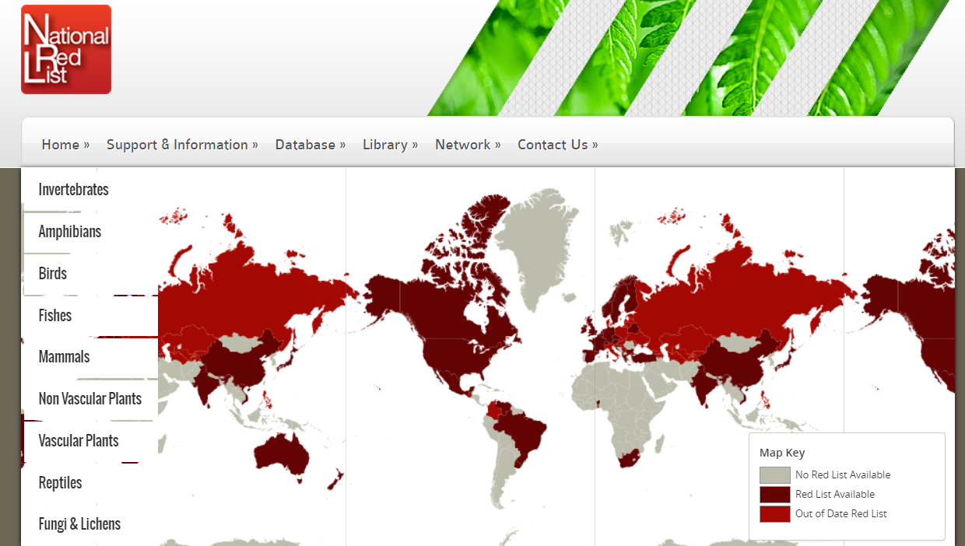
Red lists – country-level
nationalredlist.org
Notes:
OK, so here we are moving to the outer space
Spaceborne satellite sensors such as MODIS or Landsat can classify landscape to spectral species, and can measure spectral diversity
Unlike taxonomic data, spectral data suffer no sampling bias and are available over any scale
In WP4 I will seek parallels between dynamics of taxonomic and spectral diversity

Slide 8
You should know
What are the main species traits affecting extinction risk
That AOO and EOO play a key role in assessment of extinction risk
The main authority in extinction risk assessment is IUCN
You should know the main risk categories
You should know what is a red list
Notes:
OK, so here we are moving to the outer space
Spaceborne satellite sensors such as MODIS or Landsat can classify landscape to spectral species, and can measure spectral diversity
Unlike taxonomic data, spectral data suffer no sampling bias and are available over any scale
In WP4 I will seek parallels between dynamics of taxonomic and spectral diversity

Slide 9
Range collapses
How species go extinct?
Notes:
I am qualified to deliver all this

Slide 10
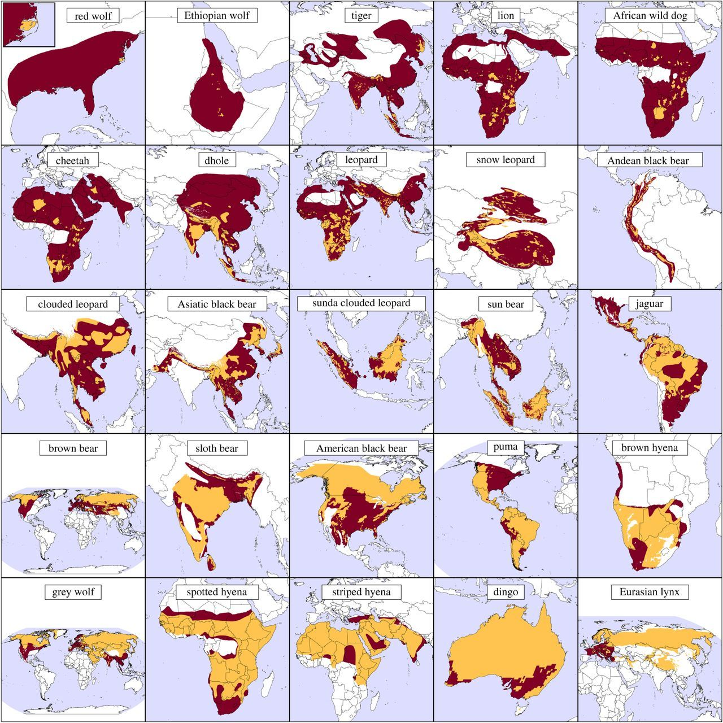
Mammal & large carnivore ranges: 1500 AD - present
173 terrestrial mammals have lost > 50% of native range. Most severe losses in areas with high population density (Ceballos & Ehrlich 2002).
In North America, 17 out of 43 large ungulates underwent contractions of > 20% (Laliberte & Ripple 2004).
Less then 21% land retains its historic range of > 20 kg mammals (Morrison et al. 2007).
Maps: Wolf & Ripple (2017) Proc. R. Soc. B
Notes:
And this is what I will address
The grand objective is to figure out…
Specifically, BEAST will ………………………
I will do this in 5 work packages.

Slide 11

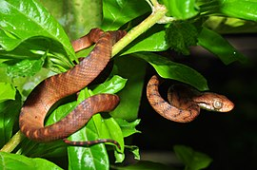
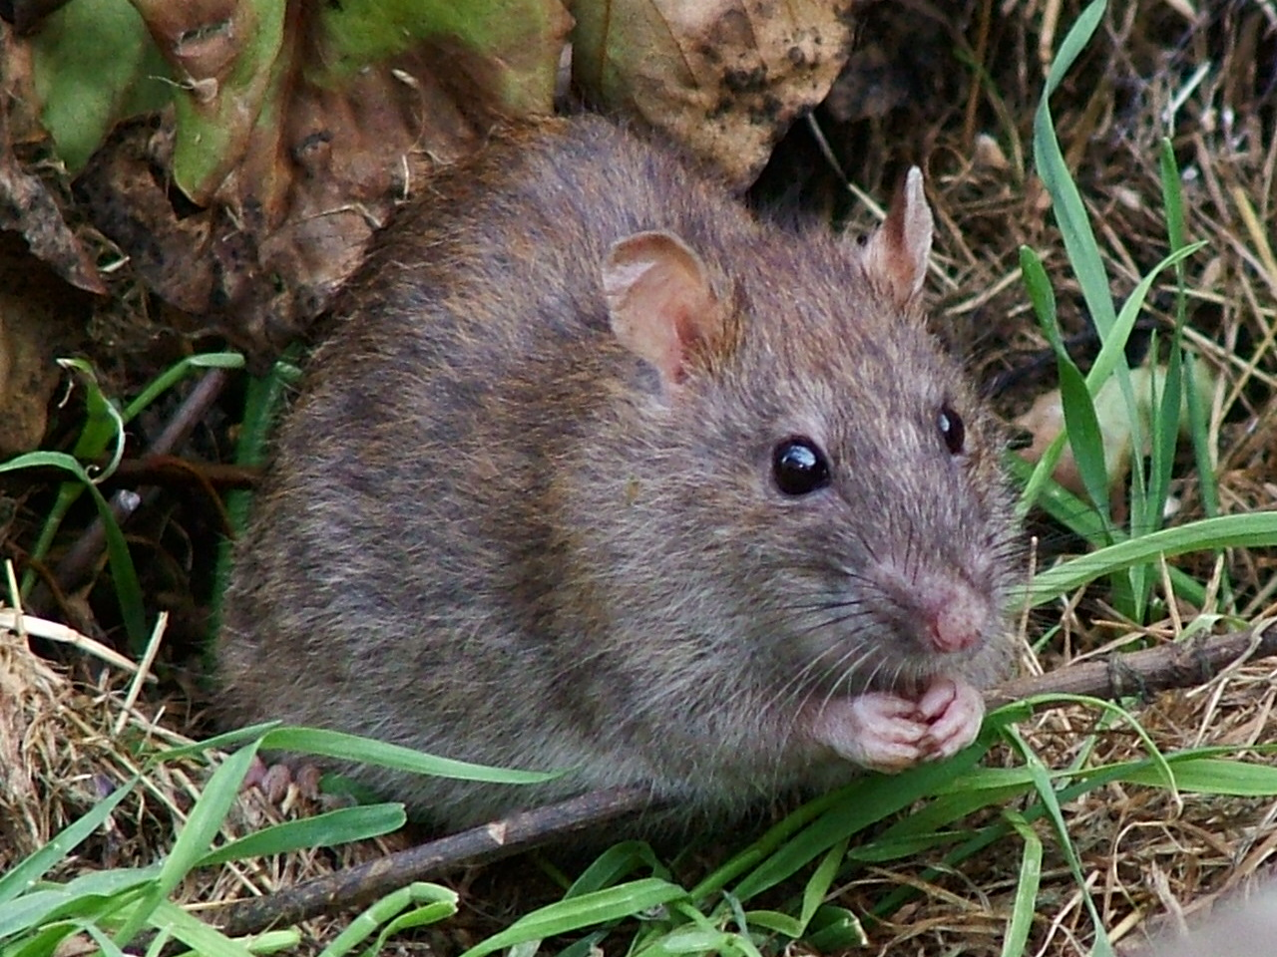
Global avian extinctions
Extinctions by realm
Extinctions by cause
Szabo et al. (2012) PLoS One
Notes:
OK, so here we are moving to the outer space
Spaceborne satellite sensors such as MODIS or Landsat can classify landscape to spectral species, and can measure spectral diversity
Unlike taxonomic data, spectral data suffer no sampling bias and are available over any scale
In WP4 I will seek parallels between dynamics of taxonomic and spectral diversity

Slide 12
Main drivers of range contractions and collapses
Threats by time
Threatened species by drivers
Pereira et al. (2012) Annual Rev. Env. Res.
Notes:
OK, so here we are moving to the outer space
Spaceborne satellite sensors such as MODIS or Landsat can classify landscape to spectral species, and can measure spectral diversity
Unlike taxonomic data, spectral data suffer no sampling bias and are available over any scale
In WP4 I will seek parallels between dynamics of taxonomic and spectral diversity

Slide 13
Geometry of range collapses
R. Wallace (1876) “On a continent, the process of extinction will take effect on the circumference of the area of distribution, because it is there that the species comes to contact with such adverse conditions or competing forms as prevent it from advancing further.”
“Melting range hypothesis” – Gaston et al. (2003) equal decline everywhere, with last populations around the center
Gaston et al. (2003) The structure and dynamics of species’ geographic ranges
Notes:
OK, so here we are moving to the outer space
Spaceborne satellite sensors such as MODIS or Landsat can classify landscape to spectral species, and can measure spectral diversity
Unlike taxonomic data, spectral data suffer no sampling bias and are available over any scale
In WP4 I will seek parallels between dynamics of taxonomic and spectral diversity

Slide 14
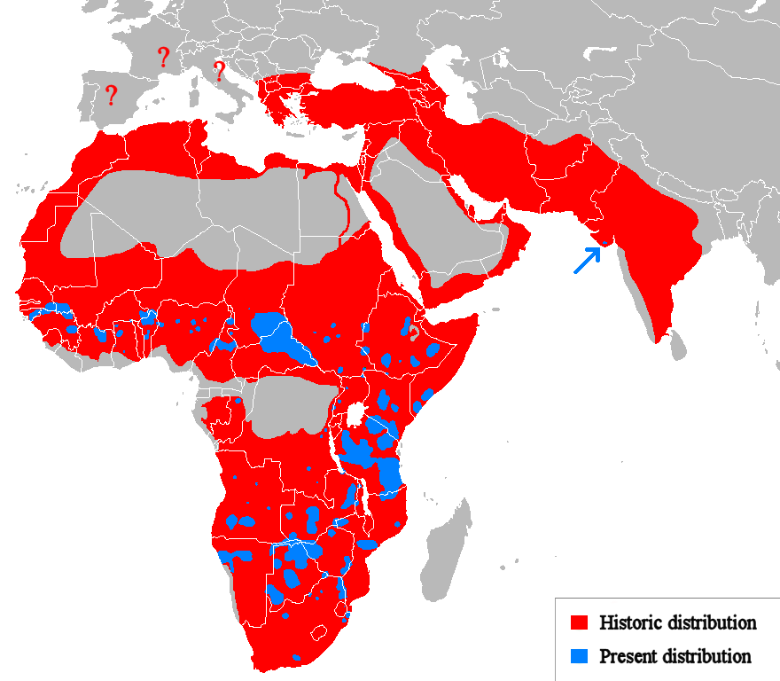
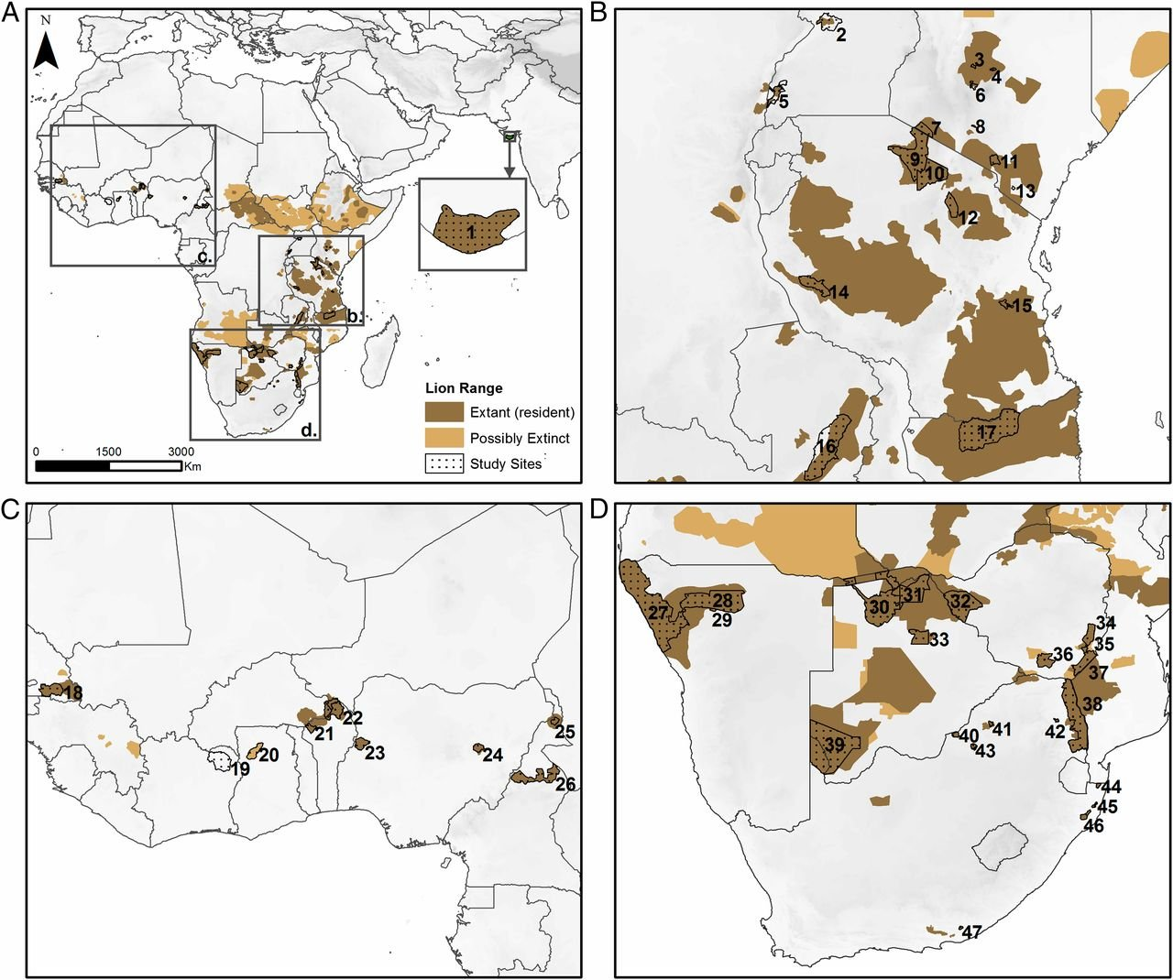
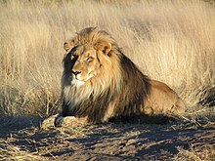
Empirical support for the melting range hypothesis is mixed
Panthera leo – The lion
Bauer et al. (2015) PNAS
Notes:
OK, so here we are moving to the outer space
Spaceborne satellite sensors such as MODIS or Landsat can classify landscape to spectral species, and can measure spectral diversity
Unlike taxonomic data, spectral data suffer no sampling bias and are available over any scale
In WP4 I will seek parallels between dynamics of taxonomic and spectral diversity

Slide 15
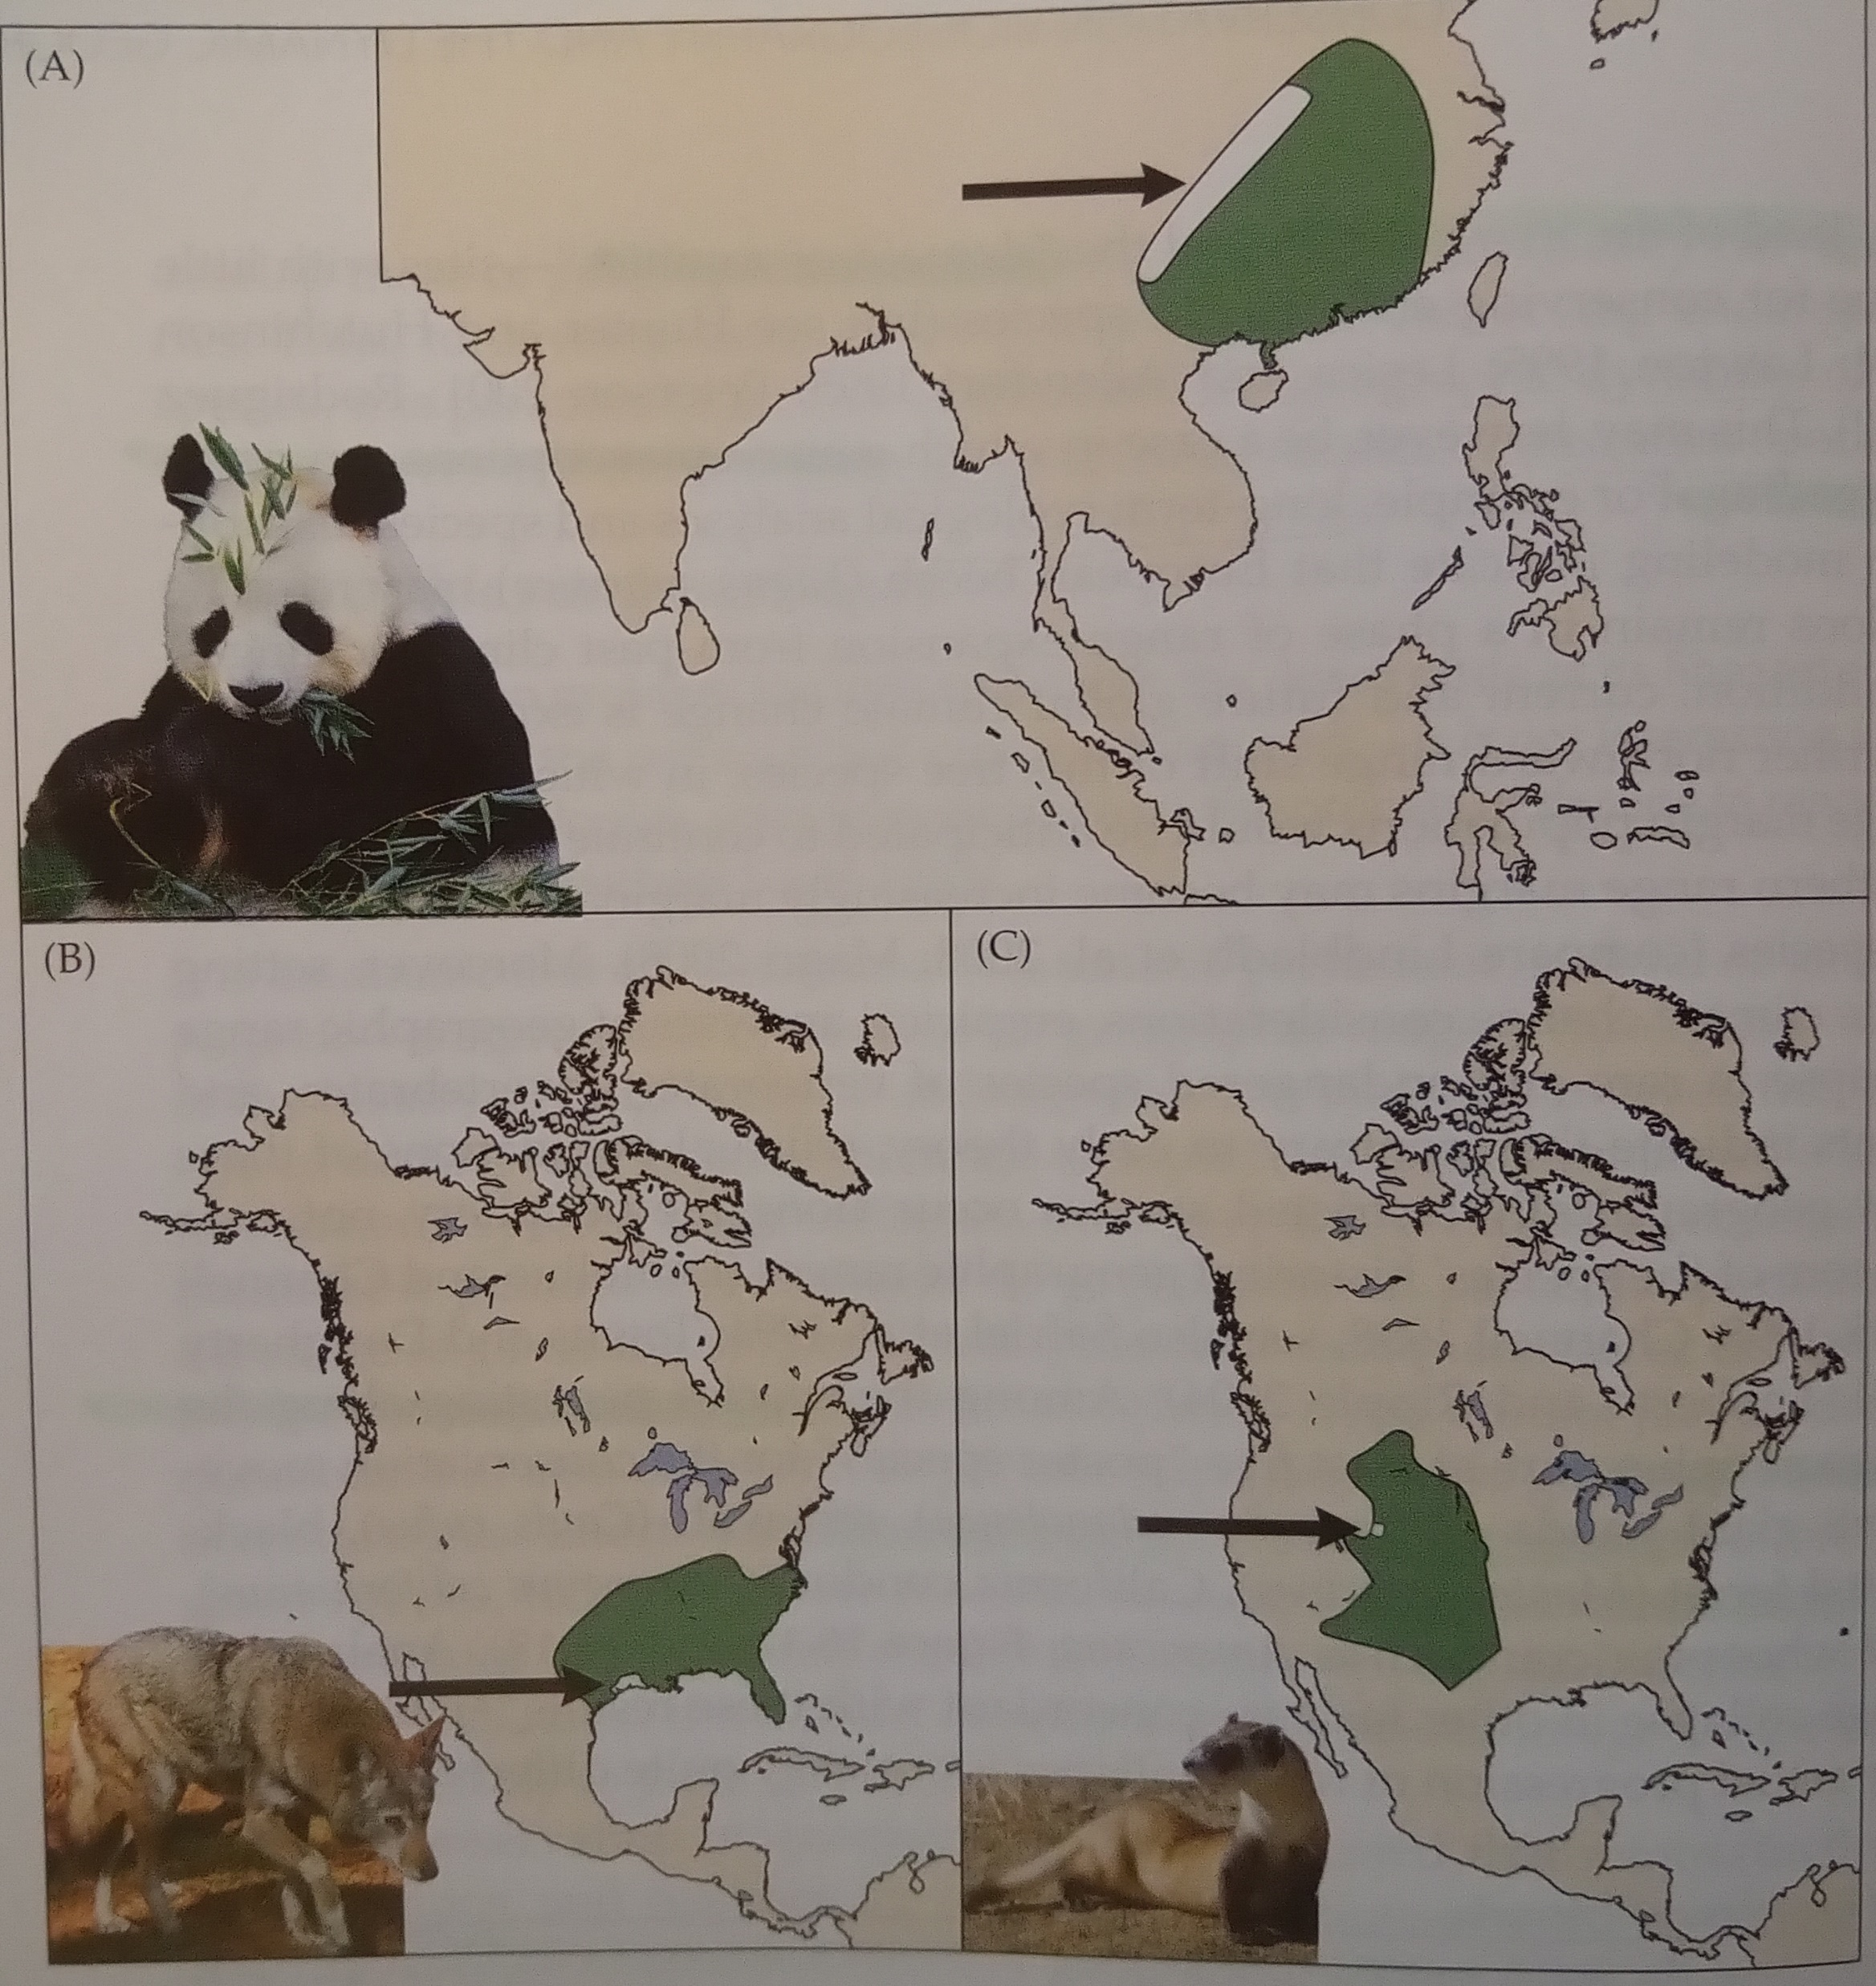
Empirical support for the melting range hypothesis is mixed
Iconic examples of species that persist around the edges:
Giant panda (Ailuropoda melanoleuca)
Red wolf (Canis rufus)
Whooping crane (Grus americana)
Lomolino et al. (2010) Biogeography
Notes:
OK, so here we are moving to the outer space
Spaceborne satellite sensors such as MODIS or Landsat can classify landscape to spectral species, and can measure spectral diversity
Unlike taxonomic data, spectral data suffer no sampling bias and are available over any scale
In WP4 I will seek parallels between dynamics of taxonomic and spectral diversity

Slide 16
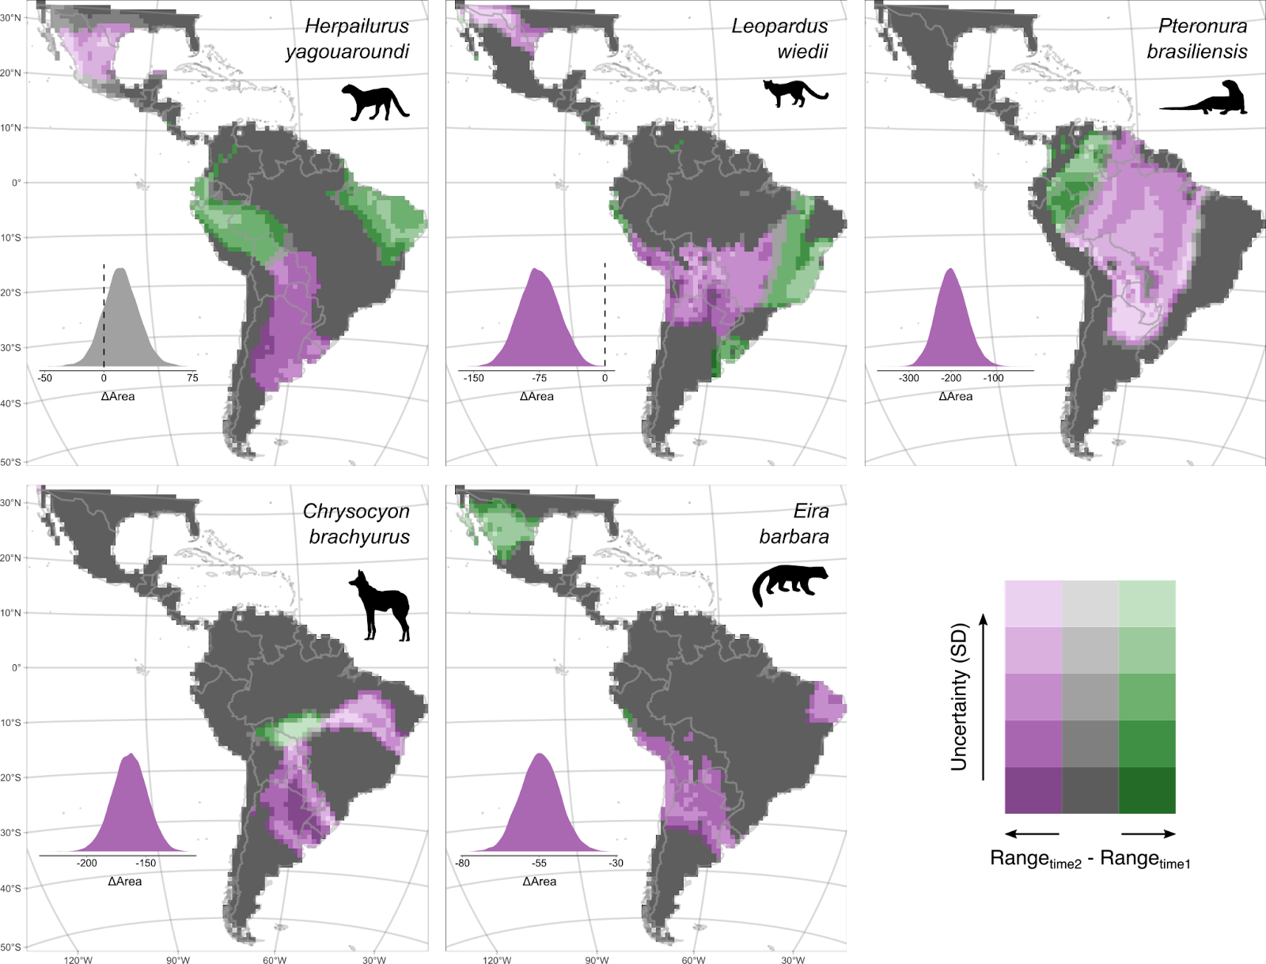

Neotropical carnivores
Flo Grattarola et al. In Preparation
Notes:
OK, so here we are moving to the outer space
Spaceborne satellite sensors such as MODIS or Landsat can classify landscape to spectral species, and can measure spectral diversity
Unlike taxonomic data, spectral data suffer no sampling bias and are available over any scale
In WP4 I will seek parallels between dynamics of taxonomic and spectral diversity

Slide 17
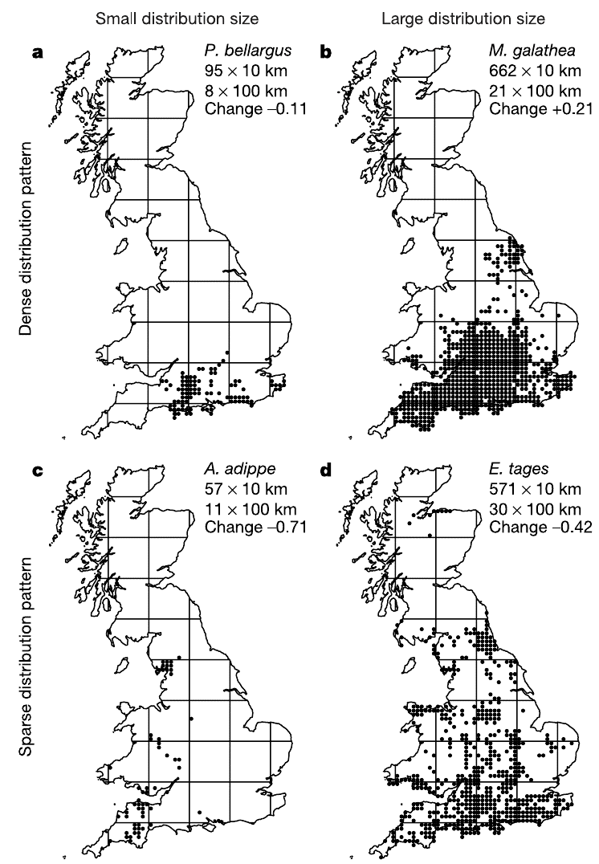
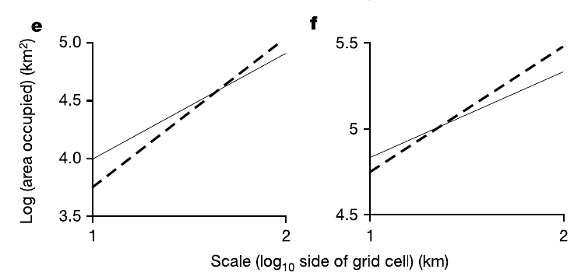
Species undergoing range collapse have different OAR*
* See previous lecture, and also Wilson et al. (2004) Nature
Notes:
OK, so here we are moving to the outer space
Spaceborne satellite sensors such as MODIS or Landsat can classify landscape to spectral species, and can measure spectral diversity
Unlike taxonomic data, spectral data suffer no sampling bias and are available over any scale
In WP4 I will seek parallels between dynamics of taxonomic and spectral diversity

Slide 18
You should know that
Range collapses, local extinctions, range contractions, and entire losses of ranges (global extinctions) are widespread, yet difficult to quantify. Reason: It’s difficult to determine that something disappeared completely.
By far the most documented range collapses and extinctions happen on islands.
Range collapses happen in many ways. There is no wide support that the center of the range remains the longest.
Main drivers of range collapses are habitat loss, exploitation, and invasive species
Notes:
OK, so here we are moving to the outer space
Spaceborne satellite sensors such as MODIS or Landsat can classify landscape to spectral species, and can measure spectral diversity
Unlike taxonomic data, spectral data suffer no sampling bias and are available over any scale
In WP4 I will seek parallels between dynamics of taxonomic and spectral diversity

Slide 19
Range expansions
Notes:
I am qualified to deliver all this

Slide 20
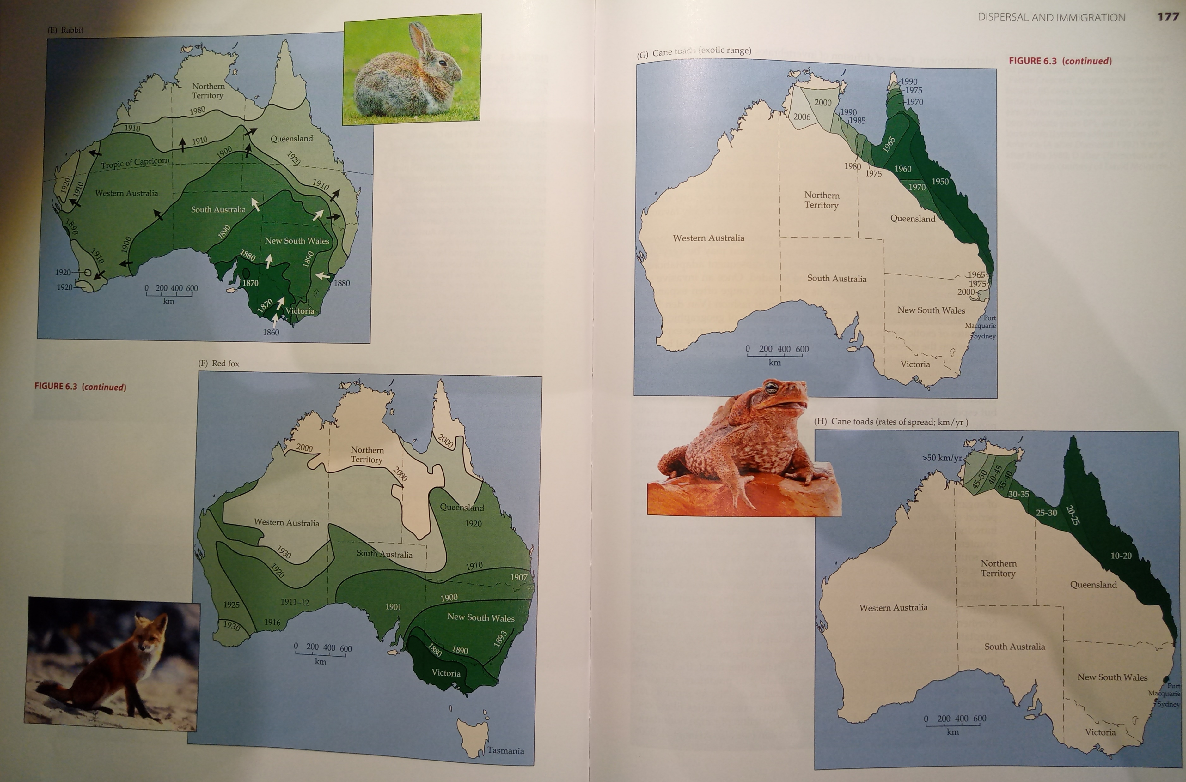
Invasive species
Maps: Lomolino et al. (2010) Biogeography
Notes:
And this is what I will address
The grand objective is to figure out…
Specifically, BEAST will ………………………
I will do this in 5 work packages.

Slide 21
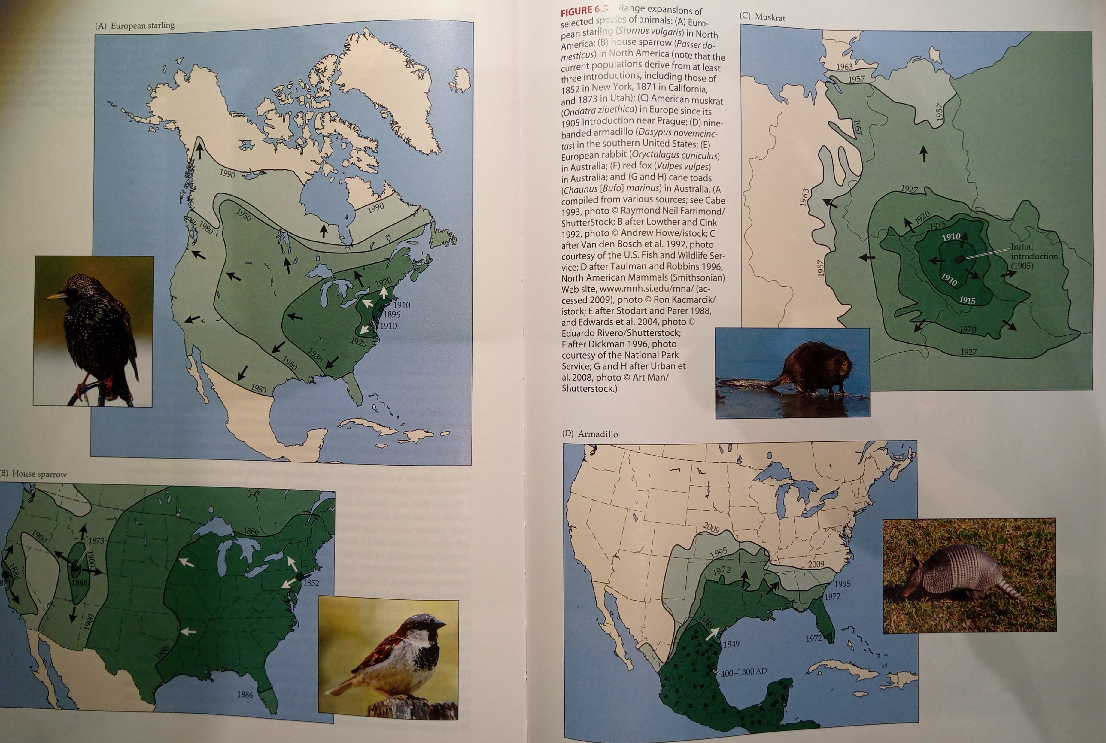
Invasive species
Ondatra zibethica
(American muskrat)
First introduction in 1905 in Prague
Maps: Lomolino et al. (2010) Biogeography
Notes:
And this is what I will address
The grand objective is to figure out…
Specifically, BEAST will ………………………
I will do this in 5 work packages.

Slide 22
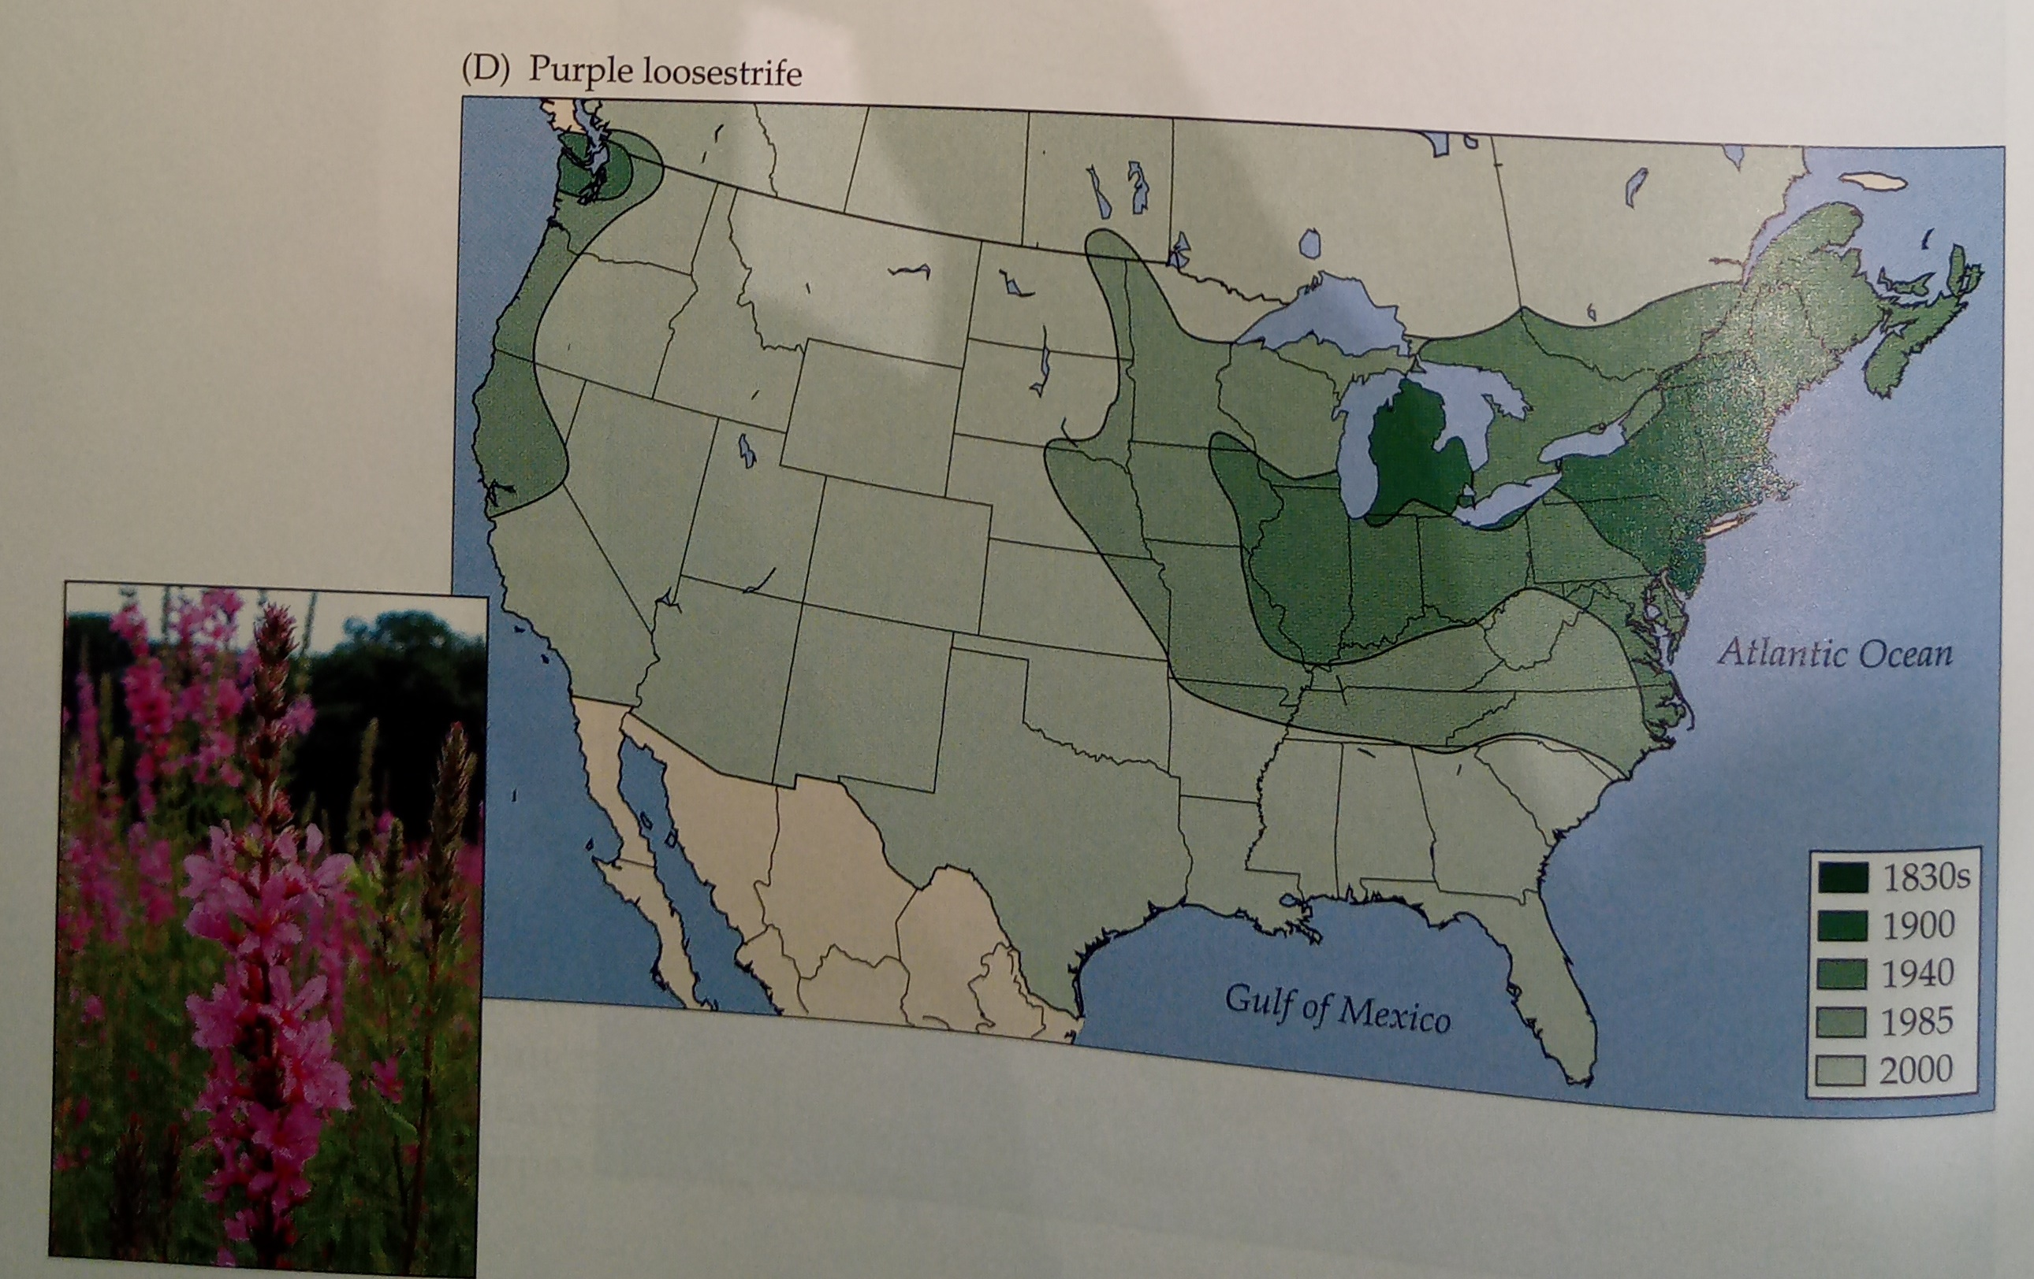
Invasive species
Lythrum salicaria
(Kyprej vrbice)
Maps: Lomolino et al. (2010) Biogeography
Notes:
And this is what I will address
The grand objective is to figure out…
Specifically, BEAST will ………………………
I will do this in 5 work packages.

Slide 23
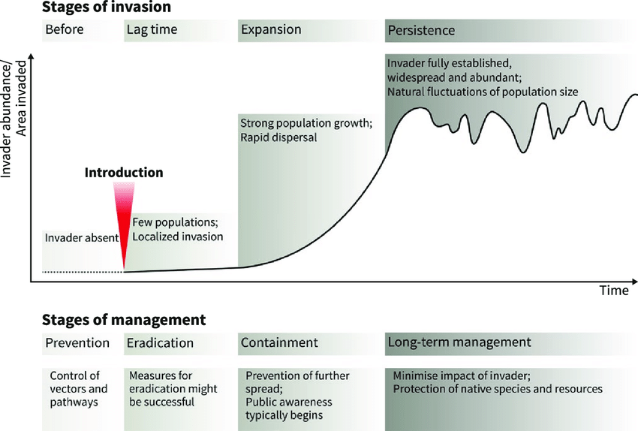
Invasive species
Boudouresque et al. (2005)
Notes:
And this is what I will address
The grand objective is to figure out…
Specifically, BEAST will ………………………
I will do this in 5 work packages.

Slide 24
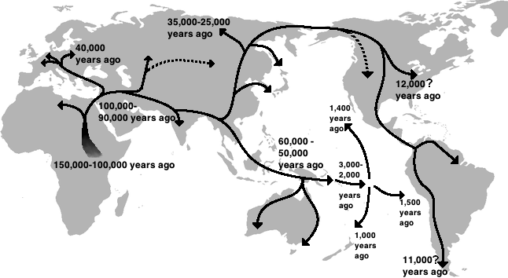
Human spread out of Africa
Map: Kyushu Museum
Notes:
And this is what I will address
The grand objective is to figure out…
Specifically, BEAST will ………………………
I will do this in 5 work packages.

Slide 25
You should know
How invasive species proceed from introduction to full invasion
Continuous spread outwards is the most common pattern of range expansion
Notes:
OK, so here we are moving to the outer space
Spaceborne satellite sensors such as MODIS or Landsat can classify landscape to spectral species, and can measure spectral diversity
Unlike taxonomic data, spectral data suffer no sampling bias and are available over any scale
In WP4 I will seek parallels between dynamics of taxonomic and spectral diversity

Slide 26
Zooming in – spatial structure of populations
An intro to metapopulation ecology
Notes:
I am qualified to deliver all this

Slide 27
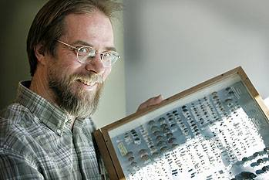
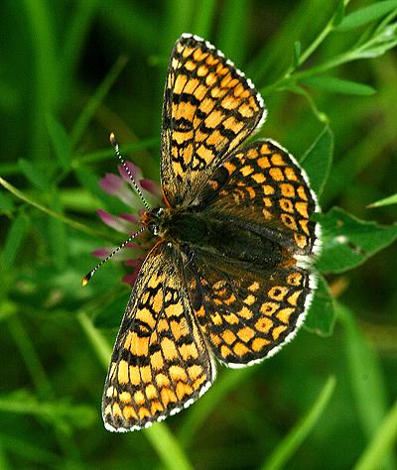
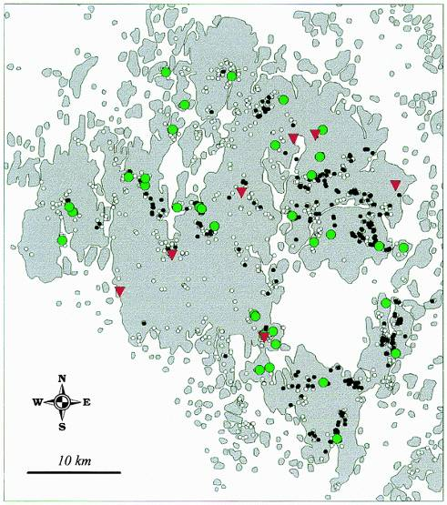
“The world is patchy”
Ilkka Hanski
Melitaea cinxia
(hnědásek kostkovaný)
Åland archipelago (Finland)
4000 patches
400 of them occupied
Hanski (1999) Metapopulation Ecology
Hanski (2011) PNAS
Notes:
And this is what I will address
The grand objective is to figure out…
Specifically, BEAST will ………………………
I will do this in 5 work packages.

Slide 28
Metapopulation = population of populations
Notes:
And this is what I will address
The grand objective is to figure out…
Specifically, BEAST will ………………………
I will do this in 5 work packages.

Slide 29
Metapopulation = population of populations
Notes:
And this is what I will address
The grand objective is to figure out…
Specifically, BEAST will ………………………
I will do this in 5 work packages.

Slide 30
Metapopulation = population of populations
Notes:
And this is what I will address
The grand objective is to figure out…
Specifically, BEAST will ………………………
I will do this in 5 work packages.

Slide 31
Metapopulation = population of populations
Notes:
And this is what I will address
The grand objective is to figure out…
Specifically, BEAST will ………………………
I will do this in 5 work packages.

Slide 32
Metapopulation = population of populations
A metapopulation is a population of populations distributed in discrete habitat patches that are linked by occasional dispersal.
Rather than track individual organisms through time, a metapopulation approach tracks the occupancy of habitat patches through time.
Metapopulation models can be used to examine factors that cause patch colonizations or patch extinctions.
Hanski (1999) Metapopulation Ecology
Van Nouhuys (2016) Metapopulation Ecology
Notes:
And this is what I will address
The grand objective is to figure out…
Specifically, BEAST will ………………………
I will do this in 5 work packages.

Slide 33
How common are metapopulations?
Probably uncommon, but metapopulation processes likely have significant role in many species
Van Nouhuys (2016) Metapopulation Ecology
Notes:
And this is what I will address
The grand objective is to figure out…
Specifically, BEAST will ………………………
I will do this in 5 work packages.

Slide 34
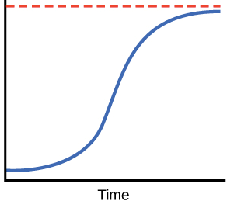
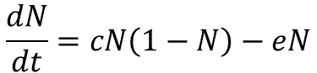
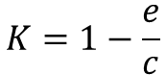
Levins’ model
N… proportion of occupied sites
c… colonization probability
e… extinction probability
t… time
K… carrying capacity
K
N
$$\frac{dN}{dt}=cN\left(1−N\right)−eN$$
$$K=1−\frac{e}{c}$$
At equilibrium, therefore, some fraction of the patches can constantly be unoccupied.
Van Nouhuys (2016) Metapopulation Ecology
Levins (1969) Bull. Entomol. Soc. Amer.
Notes:
And this is what I will address
The grand objective is to figure out…
Specifically, BEAST will ………………………
I will do this in 5 work packages.

Slide 35
Extensions of Levins’ model include:
Rescue effect – extinction rates are low in systems with high N (Hanski 1985)
Larger populations are less likely to go extinct (Hastings & Wolin 1989)
Larger empty patches are more likely to be colonized (Hastings & Wolin 1989)
Species interactions (Nee & May 1992)
Colonization is determined by connectivity (connected patches are more likely to be colonized; Hanski 1994)
Source & sink populations
Van Nouhuys (2016) Metapopulation Ecology
Notes:
OK, so here we are moving to the outer space
Spaceborne satellite sensors such as MODIS or Landsat can classify landscape to spectral species, and can measure spectral diversity
Unlike taxonomic data, spectral data suffer no sampling bias and are available over any scale
In WP4 I will seek parallels between dynamics of taxonomic and spectral diversity

Slide 36
You should know
What a metapopulation is
How common are metapopulation in real world, and where they stand on the continuum between continuous large population and completely fragmented one
That there is the Levins’ model, that it models occupancy of patches, and that it is a logistic curve
That a stable metapopulation state might be only partial occupancy that fluctuates around an equilibrium
What is a source and sink population
Notes:
OK, so here we are moving to the outer space
Spaceborne satellite sensors such as MODIS or Landsat can classify landscape to spectral species, and can measure spectral diversity
Unlike taxonomic data, spectral data suffer no sampling bias and are available over any scale
In WP4 I will seek parallels between dynamics of taxonomic and spectral diversity

Slide 37
Thank you. Questions?

